Slide 1
Chapter 06 Data type User-defined Data Type
Dr. Le Thanh Sach
Notes:
1

Slide 2
Content
Typedef
Struct
Array
Notes:
2

Slide 3
Convention
USR_DT = User-defined data type
Notes:
3

Slide 4
Typedef
typedef is a keyword used in C++ language to assign alternative names to existing types. It’s mostly used with user defined data types, when names of data types get slightly complicated.
The new name is more understandable, in the context of the problem.
Write code shorter
Can be used like fundamental data type
Notes:
4

Slide 5
Typedef
#include <iostream>
using namespace std;
/*new name for "unsigned byte"*/
typedef unsigned char byte;
int main(){
byte a = 78;
unsigned char b = 'A', c;
c = a; a = b;
cout << "a = " << a << endl;
cout << "b = " << b << endl;
cout << "c = " << c << endl;
system("pause");
return 0;
}
Notes:
5

Slide 6
Typedef
Example
New defined data type “byte” can be used as type instead of using “unsigned byte”
=> Increase the meaning of “unsigned char”
=> Your code is nicer and shorter
=> Can be used with origin data type
Variable a (of new data type) can be assigned to variable c (origin data type)
Variable a (of new data type) can receive value from variable b (origin data type)
Can print variable a (of new data type) like a number or a character
Variable a can be used in an expression where operands use origin data type
Notes:
6

Slide 7
Typedef
Or we can use typedef to:
Define new name for enum type
Define new name for struct
Notes:
7

Slide 8
Struct
Why do we need struct?
Problem: student management system
Program needs to store information for each student:
Identifier
Name
Date of birth
Address
Phone number
Email
….
Notes:
8

Slide 9
Struct
Why do we need struct?
Problem: Student management system
If we use built-in data types to store information of students in memory
Need MANY variables where each variable represents information of a student.
=> Inconvenient: ugly code, hard to understand, etc.
=> Even if we only store information of some students in memory: variable declaration lines occupy a large area of source code.
Notes:
9

Slide 10
Struct
Why do we need struct ?
Problem: Student management system
Another similar problems
Information of a point or a vector
Information of a product, goods in supermarket
...
Solution
GATHER all related data into one block
Are always allocated contiguously in memory
Are always released from memory together
Allow different component data fragments can be retrieved independently by its name
Notes:
10

Slide 11
Struct
Why do we need struct?
Solution
GATHER all related data into one block
Are always allocated contiguously in memory
Are always released from memory together
Allow different component data fragments can be retrieved independently by its name
In C: struct is used
In C++: class is used
Notes:
11

Slide 12
Struct
What is struct?
Is a composite data type consisting of partial, built-in data types. Partial types can be the same type or they can be different. They can also be struct.
In object oriented programming languages, a similar data type but with more features (Class) can be used instead of struct.
Notes:
12

Slide 13
Struct
What is struct?
Example
struct sStudent{
char id[5];
char name[50];
float gpa;
};
struct sPoint3D{
float x, y, z;
};
struct sVector3D{
float x, y, z;
};
struct sTable{
char code[10];
float width, length, height;
};
Notes:
13

Slide 14
Struct
Struct “sStudent”
Gather the relevant components (field) to describe a student
Data of each student contains:
id, name: Identifier and name of the student
Data type: array (will be covered in another chapter)
gpa: grade point average:
Data type: float
Always, CONTIGUOUS (ADJACENT) memory locations are used to store structure members in memory (struct “sStudent” in this case).
struct sStudent{
char id[5];
char name[50];
float gpa;
};
Notes:
14

Slide 15
Struct
Struct “sPoint3D” and “sVector3D”
Gather the relevant components (field) to describe a point and a vector in three dimensions.
Name of each component:
x,y,z: coordinates of point or vector
Data type: float or double
Each time the system allocates memory for a point or vector, it allocates a contiguous blocks for all the data points and vector
struct sPoint3D{
float x, y, z;
};
struct sVector3D{
float x, y, z;
};
Notes:
15

Slide 16
Struct
How to declare and use struct?
#include <iostream>
using namespace std;
struct sStudent{
char id[5];
char name[50];
float gpa;
};
int main(){
struct sStudent s1;
struct sStudent s2 = {"001", "Nguyen Van An"};
struct sStudent s3 = {"001", "Nguyen Van An", 9.5f};
cout << "ID:\t" << s3.id << endl;
cout << "NAME:\t" << s3.name << endl;
cout << "GPA:\t" << s3.gpa << endl;
return 0;
}
Notes:
16

Slide 17
Struct
How to declare and use struct ?
Define struct sStudent
#include <iostream>
using namespace std;
struct sStudent{
char id[5];
char name[50];
float gpa;
};
int main(){
struct sStudent s1;
struct sStudent s2 = {"001", "Nguyen Van An"};
struct sStudent s3 = {"001", "Nguyen Van An", 9.5f};
cout << "ID:\t" << s3.id << endl;
cout << "NAME:\t" << s3.name << endl;
cout << "GPA:\t" << s3.gpa << endl;
return 0;
}
Declare variables s1, s2, s3 with struct sStudent
S1: not assigned value
s2: incomplete initalization
s3: complete initialization
Notes:
17

Slide 18
Struct
How to declare and use Struct ?
#include <iostream>
using namespace std;
struct sStudent{
char id[5];
char name[50];
float gpa;
};
int main(){
struct sStudent s1;
struct sStudent s2 = {"001", "Nguyen Van An"};
struct sStudent s3 = {"001", "Nguyen Van An", 9.5f};
cout << "ID:\t" << s3.id << endl;
cout << "NAME:\t" << s3.name << endl;
cout << "GPA:\t" << s3.gpa << endl;
return 0;
}
Retrieve component data by name
Usage: <variable name>.<component name>
Notes:
18

Slide 19
Struct
Another example:
#include <iostream>
using namespace std;
struct sPoint3D{
float x, y, z;
};
int main(){
struct sPoint3D p1;
struct sPoint3D p2 = {1.5f, 2.5f, 3.5f};
p1.x = 1.0f; p1.y = 2.0f; p1.z = 3.0f;
cout << "p1 = (" << p1.x << "," << p1.y << "," << p1.z << ")" << endl;
cout << "p2 = (" << p2.x << "," << p2.y << "," << p2.z << ")" << endl;
return 0;
}
Note: declare and assign values
Notice how the printing was done
Notes:
19

Slide 20
Struct
Use typedef with struct
Remove keyword “struct” when declaring variables with type struct
#include <iostream>
using namespace std;
typedef struct sPoint3D{
float x, y, z;
} Point3D;
int main(){
struct sPoint3D p1 = {1.0f, 2.0f, 3.0f};
Point3D p2 = {1.0f, 2.0f, 3.0f};
cout << "p1 = (" << p1.x << "," << p1.y << "," << p1.z << ")" << endl;
cout << "p2 = (" << p2.x << "," << p2.y << "," << p2.z << ")" << endl;
}
Note: use typedef to define new data type - sPoint3D
Notes:
20

Slide 21
Struct
Use typedef with struct
Remove keyword “struct” when declaring variables with type struct
#include <iostream>
using namespace std;
typedef struct sPoint3D{
float x, y, z;
} Point3D;
int main(){
struct sPoint3D p1 = {1.0f, 2.0f, 3.0f};
Point3D p2 = {1.0f, 2.0f, 3.0f};
cout << "p1 = (" << p1.x << "," << p1.y << "," << p1.z << ")" << endl;
cout << "p2 = (" << p2.x << "," << p2.y << "," << p2.z << ")" << endl;
}
Note: use typedef to define new data type - sPoint3D
Notes: remove keyword “struct”
Notes:
21

Slide 22
Array
Notes:
22

Slide 23
Content
Why do we need array?
What is array?
1D Array
1D array declaration
Read and write element
One element
All element
Applications
2D Array
2D array declaration
Read and write element
One element
All elements
Applications
String
Notes:
23

Slide 24
Why do we need array ?
Problem: Student management system
Suppose you want to store N students in memory and only use fundamental data types
Need N x M variables
M is number of attributes for each student
N = 100 students, M = 10 attributes
=> 1000 variables!
Possible but unreasonable!
Hard to read and develop
Notes:
24

Slide 25
Why do we need array ?
Problem: Student Management System
Solution
(1) Group all data of each student together => use struct
(2) Store N students => use array
Or we can use linked list
C++
Use (array) to store contiguous elements with same data type
Use (pointer) to develop linked list if necessary
Notes:
25

Slide 26
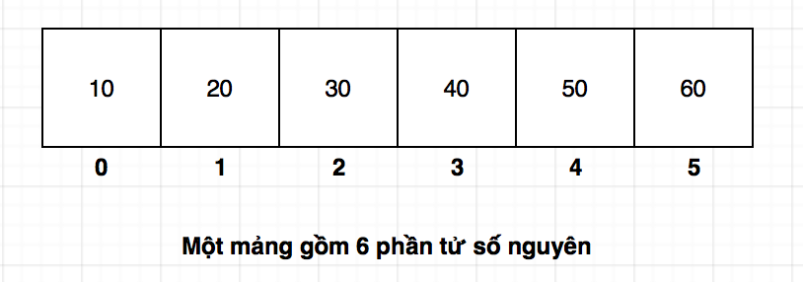
What is array ?
Array is a list of element with same data type and allocated contiguously in memory.
For example
An array contains 6 elements
Notes:
26

Slide 27
What is array ?
An array contains 6 elements
An array contain 6 numbers
These numbers allocated contiguously in memory
So,
If the value of the first element is 10 and starts at the 100th BYTE in the memory of the program
Then
Address of the second element: 104
Address of the third element: 108
Address of the fourth element: 112
Address of the fifth element 116
Address of the sixth element: 120
Notes:
27

Slide 28
What is array ?
An array contains 6 elements
An array contain 6 numbers
These numbers allocated contiguously in memory
These elements have index to access
The index of the first element is ALWAYS 0
The index of the second element is 1, and so on.
Therefore,
The index of memory cell containing value 10 is 0
The index of memory cell containing value 20 is 1
The index of memory cell containing value 30 is 2
The index of memory cell containing value 40 is 3
The index of memory cell containing value 50 is 4
The index of memory cell containing value 60 is 5
Notes:
28

Slide 29
What is array ?
An array contains 6 elements
An array contains 6 numbers
These numbers allocated contiguously in memory
These elements have index to access
The index of the first element is ALWAYS 0
The index of the second element is 1, and so on
Therefore,
If an array has N elements then the index of the last element will be (N-1) - not N
Notes:
29

Slide 30
What is array ?
An array contains 6 elements
To calculate the address of a memory cell with index k, the program uses the following formula:
Address = address of first element + k * (size of element)
Therefore, the program easily points out an element at any index => RANDOM ACCESS
Notes:
30

Slide 31
What is array ?
An array contains 6 elements
However, compiler must know the size of the array
Therefore, we can calculate address of k^{th} element in the memory by using this formula:
first: address of the first element
first is name of variable of array
Address of k^{th} element = first + k
An array contains 6 elements
Notes:
31

Slide 32
1D Array Declaration
int main(){
int a[6];
int b[6] = {10, 20, 30};
int c[6] = {10, 20, 30, 40, 50, 60};
return 0;
}
a: an array of 6 integers
Element values are unknown
b: an array of 6 integers
First 3 element values are 10, 20, and 30
Last 3 element values are unknown
c: an array of 6 integers
Element values are 10, 20, 30, 40, 50, and 60
Notes:
32

Slide 33
1D Array Declaration
Notes:
All variables a, b, and c are array containing 6 elements
So, the index starts from 0 to 5
int main(){
int a[6];
int b[6] = {10, 20, 30};
int c[6] = {10, 20, 30, 40, 50, 60};
return 0;
}
Notes:
33

Slide 34
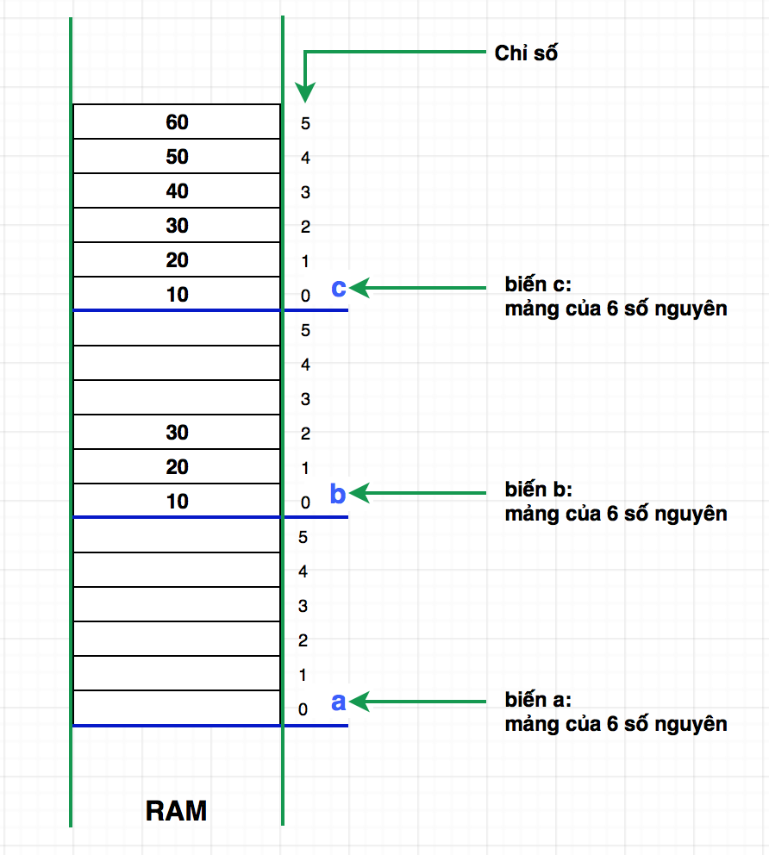
1D Array Declaration
Index
How are arrays (a, b, and c) allocated in memory?
Variable c:
6 integers
Variable b:
6 integers
Variable a:
6 integers
Notes:
34

Slide 35
1D Array Declaration
Number of elements in array
Must be determined at compile time
Is constant and non-negative
Use macro
#define MAX_SIZE
Use int const
const int max_size
#define MAX_SIZE 6
int main(){
const int max_size = 10;
int a[MAX_SIZE];
int b[max_size];
return 0;
}
Notes:
35

Slide 36
1D Array Read and write elements of 1D array
Two ways:
By index
By address of memory
Notes:
36

Slide 37
1D Array Read and write element of 1D array
Two ways:
By index
#include <iostream>
using namespace std;
int main(){
int c[6] = {10, 20, 30, 40, 50, 60};
int id = 0;
/*Write to element*/
c[3] = 99;
c[id + 1] = 100;
/*Read and print element*/
cout << "c[3] = " << c[3] << endl;
cout << "c[" << id + 1 << "] = " << c[id + 1] << endl;
return 0;
}
Notes:
37

Slide 38
1D Array Read and write element of 1D array
Two ways:
By index
#include <iostream>
using namespace std;
int main(){
int c[6] = {10, 20, 30, 40, 50, 60};
int id = 0;
/*Write to element*/
c[3] = 99;
c[id + 1] = 100;
/*Read and print element*/
cout << "c[3] = " << c[3] << endl;
cout << "c[" << id + 1 << "] = " << c[id + 1] << endl;
return 0;
}
Can be constant
General: index can be any positive integer expression
Notes:
38

Slide 39

1D Array Read and write element of 1D array
Two ways:
By index
#include <iostream>
using namespace std;
int main(){
int c[6] = {10, 20, 30, 40, 50, 60};
int id = 0;
/*Write to element*/
c[3] = 99;
c[id + 1] = 100;
/*Read and print element*/
cout << "c[3] = " << c[3] << endl;
cout << "c[" << id + 1 << "] = " << c[id + 1] << endl;
return 0;
}
Notes:
39

Slide 40
1D Array Read and write element of 1D array
Two ways:
By address in memory
#include <iostream>
using namespace std;
int main(){
int c[6] = {10, 20, 30, 40, 50, 60};
int id = 0;
/*Write to element*/
*(c + 3) = 99;
*(c + (id + 1)) = 100;
/*Read and print element*/
cout << "c[3] = " << *(c + 3) << endl;
cout << "c[" << id + 1 << "] = " << *(c + (id + 1)) << endl;
return 0;
}
Notes:
40

Slide 41
1D Array Read and write element of 1D array
Two ways:
By address in memory
(1) Calculate address
(2) Get element by calculated address
(1) Calculate address
(use first+ k formula)
*(c + 3) = 99;
(2) Get element at an address: * operator
Notes:
41

Slide 42
1D Array Read and write element of 1D array
Two ways:
Calculate the address and receive reference to the wanted element
Calculate the address
Receive reference to the wanted element
*(c + 3) = 99;
Address of the first element in array:
Use name of array:
c
Or, use & operator:
&c[0]: the & operand
Notes:
42

Slide 43
1D Array Some techniques in 1D array
Access array elements
Calculate statistical values from array
Sum
Maximum
Minimum
Median
Standard variation
Mean
...
Element-wise operation
Normalize all element (student, product, etc) in array
Swap two elements in an array
Sorting
Sort all elements in an array
Find an element in an array
Binary search
Notes:
43

Slide 44
1D Array Some techniques in 1D array
Access array elements
Use 1 index variable (int type)
Assign value 0 to this variable
Indicate the first element of array
Loop through an array
For each iteration,
Access element by index: read or write
Increase index variable by 1
Notes:
44
44

Slide 45

1D Array Some techniques in 1D array
Access array elements
#include <iostream>
using namespace std;
#define MAX_SIZE 100
int main(){
int arr[MAX_SIZE];
int cur_size = 5; //use 5 items only
/*Initialize array*/
for(int i=0; i<cur_size; i++){
arr[i] = i*i;
}
/*Print array*/
for(int i=0; i<cur_size; i++){
cout << arr[i] << “ “;
}
return 0;
}
Notes:
45

Slide 46
1D Array Some techniques in 1D array
Access array elements
MAX_SIZE (100) is positive integer
#include <iostream>
using namespace std;
#define MAX_SIZE 100
int main(){
int arr[MAX_SIZE];
int cur_size = 5; //use 5 items only
/*Initialize array*/
for(int i=0; i<cur_size; i++){
arr[i] = i*i;
}
/*Print array*/
for(int i=0; i<cur_size; i++){
cout << arr[i] << “ “;
}
return 0;
}
cur_sizee: number of elements are being used (can be determined by user)
For loop: iterate through all elements to read and print into console
Notes:
46

Slide 47
1D Array Some techniques in 1D array
Access array elements
Exercise
Use for loop but the stopping condition should be put inside the for scope { }
For(;;){…}
Use break
Other loop types
while
do ... while
Notes:
47

Slide 48
1D Array Some techniques in 1D array
Calculate sum of all elements in array
Loop
Recursion (will be covered in a future chapter)
Notes:
48

Slide 49
1D Array Some techniques in 1D array
Calculate sum of all elements in array
Loop
Let sum be the sum of all elements in array
Initialize sum = 0
Use loop to iterate through all elements in array
For each iteration,
Read element by index
Add value the element at the specific index to sum
Increase index variable by 1
Notes:
49

Slide 50
#include <iostream>
using namespace std;
#define MAX_SIZE 100
int main(){
int arr[MAX_SIZE];
int cur_size = 5; //use 5 items only
/*Initialize array*/
for(int i=0; i<cur_size; i++){
arr[i] = i*i;
}
/*Print array*/
cout << "ARRAY's elements: " << endl;
for(int i=0; i<cur_size; i++){
cout << arr[i] << “ ”;
}
//...
}
Notes:
50

Slide 51
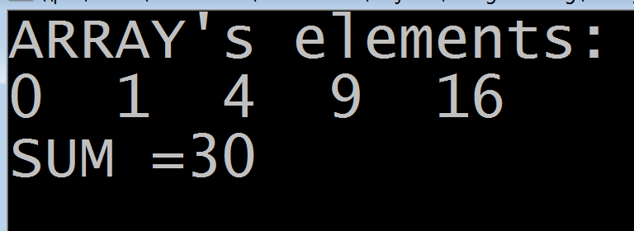
#include <iostream>
using namespace std;
#define MAX_SIZE 100
int main(){
int arr[MAX_SIZE];
int cur_size = 5; //use 5 items only
/*Initialize array*/
for(int i=0; i<cur_size; i++){
arr[i] = i*i;
}
//...
/*Calculate sum*/
int sum = 0;
for(int i=0; i<cur_size; i++){
sum += arr[i];
}
cout << "SUM = " << sum << endl;
return 0;
}
For loop: loop through all elements and add value to sum.
Notes:
51

Slide 52
1D Array Some techniques in 1D array
Find maximum value
Let max_value be the maximum value
Initialize max_value = smaller than the smallest value
Or assign value of the first element of the array to max_value
Loop through all elements
For each element at index ID,
If value of this element LARGER THAN max_value
Assign max_value = value of this element
Increase index variable by 1
Notes:
52

Slide 53
1D Array Some techniques in 1D array
Find minimum value
Let min_value be the minimum value
Initialize min_value = larger than the largest element
Or assign value of the first element in the array to min_value
Loop through all element
For each element at index ID,
If value of this element SMALLER THAN min_value
Assign min_value = value of this element
Increase index variable by 1
Notes:
53

Slide 54
1D Array Some techniques in 1D array
Find maximum/minimum value
Problem
Each student has attributes:
Identifier (code), name (name), math score (math), english score (english), and phisics score (physics)
Let N be the number of students
Program starts with all score values assigned randomly from 0 to 10. Identifer and name of student do not need initialization
Find maximum and minimum value and print into console.
Notes:
54

Slide 55
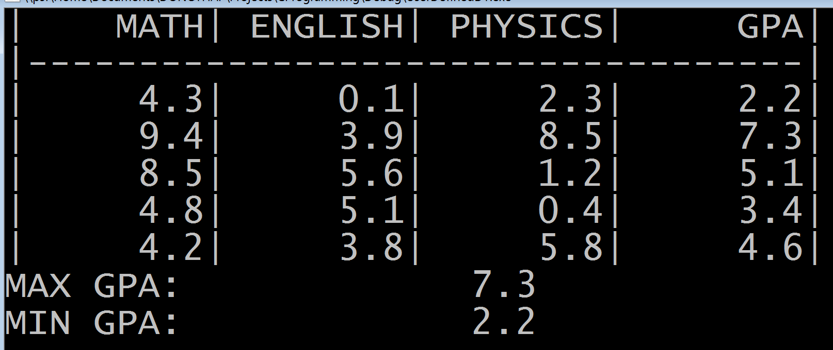
1D Array Some techniques in 1D array
Find maximum/minimum value
Bài toán
Mỗi sinh viên có chứa
Mã số (code), tên (name), điểm Toán (math), Anh văn (english), và Lý (physics)
Giả sử có danh sách của N sinh viên.
Chương trình khởi động danh sách với 3 cột điểm sinh ngẫu nhiên từ 0 đến 10. Mã số và tên của sinh viên chưa cần gán
Tìm điểm trung bình lớn nhất và nhỏ nhất và in ra màn hình. Kết quả như hình sau
Notes:
55

Slide 56
1D Array Some techniques in 1D array
Find maximum/minimum value
Analysis:
Need to define a new data type, Student, which contains the information fields as mentioned previously
Save a list of up to NUM_STUDENT students.
Initialize array as required
3 score columns are random initialized from 0 to 10
Find highest and lowest average scores and print them on the console
Average = (math + english + physics) / 3
Implement the program
Notes:
56

Slide 57
1D Array Some techniques in 1D array
Find maximum/minimum value
Struct (Student)
typedef struct sStudent{
char student_code[10];
char student_name[50];
float math, english, physics;
} Student;
Notes:
57

Slide 58
1D Array Some techniques in 1D array
Find maximum / minimum value
Declare an array has NUM_STUDENT elements
#include <time.h>
#define NUM_STUDENT 5
typedef struct sStudent{
char student_code[10];
char student_name[50];
float math, english, physics;
} Student;
int main(){
/*List of students*/
Student list[MAX_SIZE];
/...
To use time function
Notes:
58

Slide 59
1D Array Some techniques in 1D array
Find maximum/minimum value
Initialize array
/*Initialize the list*/
time_t t;
srand((unsigned) time(&t));
for(int i=0; i<NUM_STUDENT ; i++){
list[i].math = ((float)rand() / RAND_MAX)*10;
list[i].english = ((float)rand() / RAND_MAX)*10;
list[i].physics = ((float)rand() / RAND_MAX)*10;
}
Use rand() function to generate integers from 0 to RAND_MAX (constant)
rand()/RAND_MAX: from 0 to 1
(rand()/RAND_MAX)*10: from 0 to 10
srand: create random generator based on system time (function time). Without this, every time you run the program, the randomized values always stay the same.
Notes:
59

Slide 60
1D Array Some techniques in 1D array
Find maximum / minimum value
Find largest / smallest element in array
/*Find max gpa and min gpa*/
float gpa_max = -1.0f;
float gpa_min = 11.0f;
float gpa;
for(int i=0; i<NUM_STUDENT; i++){
gpa = (list[i].math + list[i].english + list[i].physics)/3;
if(gpa_max < gpa) gpa_max = gpa;
if(gpa_min > gpa) gpa_min = gpa;
}
Notes:
60

Slide 61
1D Array Some techniques in 1D array
Find maximum / minimum value
Print array and largest, smallest element into console
/*Print scoreboard, max gpa, and min gpa*/
cout << "|" << setw(8) << "MATH"
<< "|" << setw(8) << "ENGLISH"
<< "|" << setw(8) << "PHYSICS"
<< "|" << setw(8) << "GPA|" << endl;
cout << "|-----------------------------------|" << endl;
for(int i=0; i<NUM_STUDENT; i++){
gpa = (list[i].math + list[i].english + list[i].physics)/3;
cout << "|" << setw(8) << list[i].math
<< "|" << setw(8) << list[i].english
<< "|" << setw(8) << list[i].physics
<< "|" << setw(8) << gpa << endl;
}
cout << "MAX GPA:" << gpa_max << endl;
cout << "MIN GPA:" << gpa_min << endl;
Notes:
61

Slide 62
2D array
Application
Matrices in mathematics (Linear algebra) are 2D arrays
Digital image is a 2D array of pixels
Graph (network of objects) can be represented using 2D arrays
Notes:
62

Slide 63
2D array Model vs Physical storage
10
20
30
40
50
60
70
80
90
100
110
120
A model of an 2D array has: 3 rows x 4 columns
10
20
30
40
50
60
70
80
90
100
110
120
Physical storage of 2D array: linearize 2D array
Method: array is stored row after row
Notes:
63

Slide 64
2D array How are 2D arrays stored?
Elements are stored consecutively, row after row
If the first element (value 10) begins at BYTE with address 100
Element with value 20 has address: 104
Element with value 30 has address: 108
Element with value 50 has address: 116
Element with value 60 has address: 120
Element with value 90 has address: 132
Element with value 100 has address: 136
V.v
Notes:
64

Slide 65
2D array How are 2D arrays stored?
Elements are saved consecutively, row after row
Elements in 2D array are indexed for accessing, using 2 types of index
Let row and col be indexes of an element
Row and col range from 0 to (numRow -1) and (numCol -1) respectively.
col
0
1
2
3
0
10
20
30
40
row
1
50
60
70
80
2
90
100
110
120
Notes:
65

Slide 66
2D array How are 2D arrays stored?
Elements are saved consecutively, row after row
Elements in 2D array are indexed for accessing, using 2 types of index.
Program can calculate the address of the start memory block of element [row, col] easily
Address of element [row, col] = address of the first element + [row* (number of elements on each row) + col] * size of element
col
0
1
2
3
0
10
20
30
40
row
1
50
60
70
80
2
90
100
110
120
Notes:
66

Slide 67
2D array How are 2D arrays stored?
C++ compiler knows the size of an element. Therefore, programmers can calculate the address of the element [row, col]
Address of element [row, col] = first + [row* COLS + col]
first: address of the first element
Which is the array name
COLS: number of elements on each row
col
0
1
2
3
0
10
20
30
40
row
1
50
60
70
80
2
90
100
110
120
Notes:
67

Slide 68
2D array 2D array declaration
int main(){
int a[3][4];
int b[3][4] = { {10, 20, 30} };
int c[3][4] = { {10, 20, 30, 40},
{50, 60},
};
int d[3][4] = { {10, 20, 30, 40},
{50, 60, 70, 80},
{90, 100, 110, 120}
};
return 0;
}
Notes:
68

Slide 69
2D array 2D array declaration
Declared with incompletely initialization
Size: 3 rows, 4 columns
Declare a 2D array without initialization
Size: 3 rows, 4 columns
int main(){
int a[3][4];
int b[3][4] = { {10, 20, 30} };
int c[3][4] = { {10, 20, 30, 40},
{50, 60},
};
int d[3][4] = { {10, 20, 30, 40},
{50, 60, 70, 80},
{90, 100, 110, 120}
};
return 0;
}
Declared with complete initialization
Size: 3 rows, 4 columns
Notes:
69

Slide 70
2D array Read and write elements of 2D array
Array declaration: Size 3 rows, 4 columns
int main(){
int a[3][4];
int r,c;
r = 0, c = 2;
a[r][c] = 99;
cout << "a[" << r << "][" << c << "] = " << a[r][c] << endl;
return 0;
}
Assign value to element
Need row index and col index
Rol and column: integer expression
Get value of element
Need row index and col index
Notes:
70
70

Slide 71
2D array Some techniques in 2D array
Access array elements
Access elements in the same row
Access elements in the same column
In square matrix
Access elements in the main diagonal
Access elements in the secondary diagonal
Access elements above the main diagonal
Access elements below the main diagonal
Notes:
71
71

Slide 72
2D array Access array elements
Let ROWS and COLS be the total number of rows and columns respectively
ROWS and COLS are constants
Through #define
Through const int ROWS, COLS;
Let row and col be two variables indicating the row index and column index
row: row index
col: column index
Notes:
72
72

Slide 73
2D array Access array elements
Let ROWS and COLS be the total number of rows and columns respectively
ROWS and COLS are constants
Through #define
Through const int ROWS, COLS;
Let row and col be two variables indicating the row index and column index
row: row index
col: column index
Use to nested loop
For each row
For each column
Retrieve element at [row, col] to write or read
Increase the column index (col) to access the next element in the same row
Increase the row index (row) to access the next row
Notes:
73
73

Slide 74
2D array Accessing array elements
Note
According to this method, array elements are accessed sequentially in each row, from one row to another.
Column index increases faster than row index
This method is more effective than the column-based retrieving methods
Row index increases faster than column index
Notes:
74
74

Slide 75
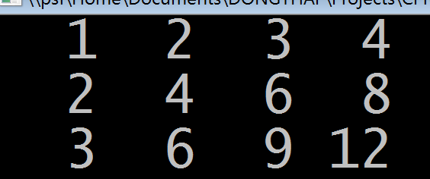
#include <iostream>
#include <iomanip>
using namespace std;
int main(){
const int ROWS = 3, COLS = 4;
int a[ROWS][COLS];
int row,col;
/*Initialize array*/
for(row=0; row<ROWS; row++){
for(col=0; col<COLS; col++){
a[row][col] = (row + 1)*(col + 1);
}
}
/*Print array*/
for(row=0; row<ROWS; row++){
for(col=0; col<COLS; col++){
cout << a[row][col] << “ “;
}
cout << endl;
}
return 0;
}
Loop over the rows, then the columns (nested)
Access and assign value
Access and print value
New line after printing each row
Notes:
75
75

Slide 76
String
Notes:
76

Slide 77
Content
String in C++
String declaration in C++
String processing functions
Print string function
Read string function
Get length of string function
Some techniques
Find substring
Remove whitespace between words and trailing whitespace
Concatenate strings
Split string
Into tokens
Into first name and surname
Notes:
77

Slide 78
String in C++
In C++, String is an array of characters which is terminated by a special null character ‘\0’
=> A character array of size N can hold only up to (N-1) characters
Example: string “LAP TRINH”
Length: 9 characters
Number of necessary memory blocks: 10
’L’
’A’
’P’
’ ’
’T’
’R’
’I’
’N’
’H’
’\0’
String ending with special character
Notes:
78

Slide 79
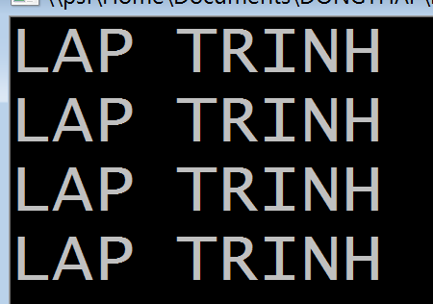
String declaration
#include <iostream>
using namespace std;
int main(){
const int MAX_LEN = 50;
char s1[MAX_LEN];
char s2[MAX_LEN] =
{'L', 'A', 'P', ' ', 'T', 'R', 'I', 'N', 'H', '\0'};
char s3[MAX_LEN] = "LAP TRINH";
char s4[] =
{'L', 'A', 'P', ' ', 'T', 'R', 'I', 'N', 'H', '\0'};
char s5[] = "LAP TRINH";
cout << s2 << endl << s3 << endl << s4 << endl << s5 << endl;
return 0;
}
Notes:
79

Slide 80
String declaration
char s1[MAX_LEN];
s1: can hold up to (MAX_LEN – 1) characters
char s2[MAX_LEN] =
{'L', 'A', 'P', ' ', 'T', 'R', 'I', 'N', 'H', '\0'};
s2: can hold up to (MAX_LEN – 1) characters
String initialization using array initialization → need to be terminated by ‘\0’
char s3[MAX_LEN] = "LAP TRINH";
s3: can hold up to (MAX_LEN – 1) characters
Initialization using constant → no need for ’\0’
Notes:
80

Slide 81
String declaration
char s4[] =
{'L', 'A', 'P', ' ', 'T', 'R', 'I', 'N', 'H', '\0'};
s4: array of 10 memory blocks, hold exactly 9 characters of string “LAP TRINH”
No need to specify the array size when declaring with string initialization
Initialize the same way as array initialization
char s5[] = "LAP TRINH";
s5: array of 10 memory blocks, hold exactly 9 of string “LAP TRINH”
No need to specify the array size when declaring with string initialization
Initialize using constant “LAP TRINH”
Notes:
81

Slide 82
Some string function library
Print string function
Function: cout
#include <iostream>
using namespace std;
int main(){
const int MAX_LEN = 50;
char s1[MAX_LEN] =
{'L', 'A', 'P', ' ', 'T', 'R', 'I', 'N', 'H', '\0'};
char s2[] = "LAP TRINH";
cout << s1 << endl << s2 << endl;
return 0;
}
Print our two strings, s1 and s2
Notes:
82

Slide 83
Some string function library
Read string function: read a word
Function: cin
#include <iostream>
#include <string>
using namespace std;
int main(){
string str;
cout << "Enter a word: ";
cin >> str;
cout << str << endl;
return 0;
}
cin: Read until reaching a whitespace → read word
Notes:
83

Slide 84
Some string function library
Read string function: read a line
Function: getline read until reaching a newline character (ENTER)
#include <iostream>
#include <string>
using namespace std;
int main(){
string str;
cout << "Enter a line: ";
getline(cin, str);
cout << str << endl;
return 0;
}
getline: Read until reaching a newline character → read line
Notes:
84

Slide 85
Some string function library
Read string function: read a line
Use getchar(), until reaching newline character (ENTER)
#include <iostream>
#include <stdio.h>
using namespace std;
int main(){
const int max_len = 50;
char str[max_len], ch = '\0';
int i=0;
cout << "Enter a string, " << max_len << "chars max: " << endl;
while(ch!='\n'){
ch=getchar();
str[i]=ch;
i++;
}
str[i]='\0'; //ending string
cout <<"line: " << str;
return 0;
}
getchar: Read each character
Notes:
85

Slide 86
Some string function library
Read string function:
Should not use cin and getline in the same program
cin: Do not read newline character → use getline right after cin can return value immediately without input from user.
Notes:
86

Slide 87
Some string function library
Another functions:
Function | Explanation
strlen | Get length of a string
strcpy | Copy one string to another
strcmp | Compare two strings
strstr | Find string in string
Further reading:
http://www.cplusplus.com/reference/cstring/
Notes:
87

